Slide 1
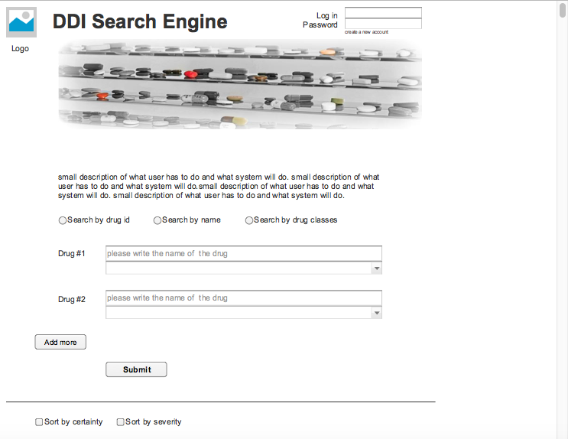

Slide 2


Slide 3
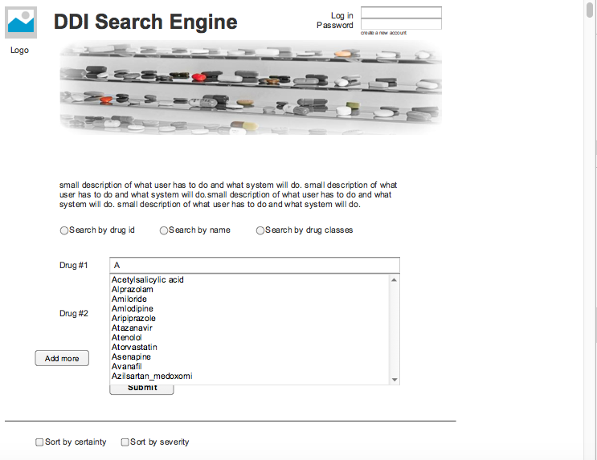

Slide 4
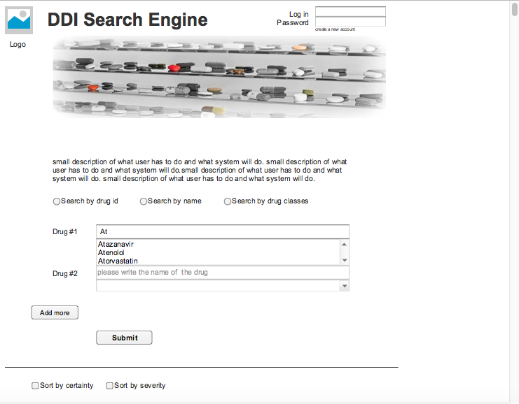

Slide 5
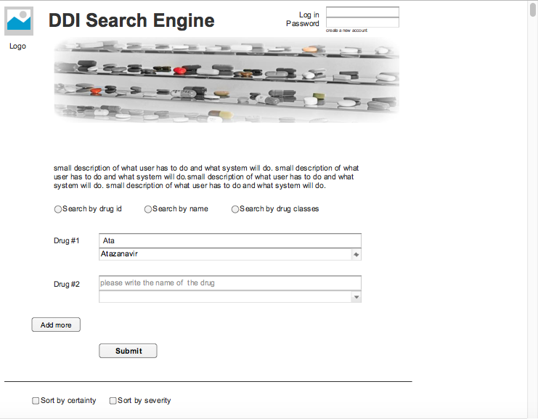

Slide 6


Slide 7
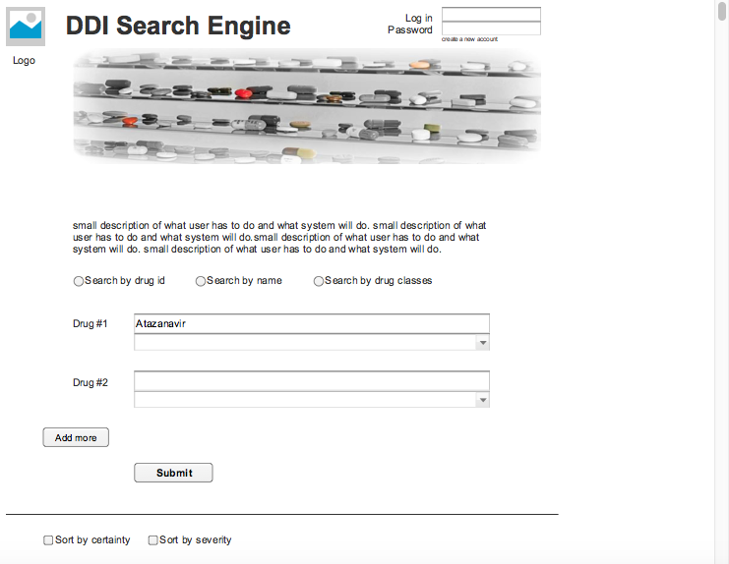

Slide 8
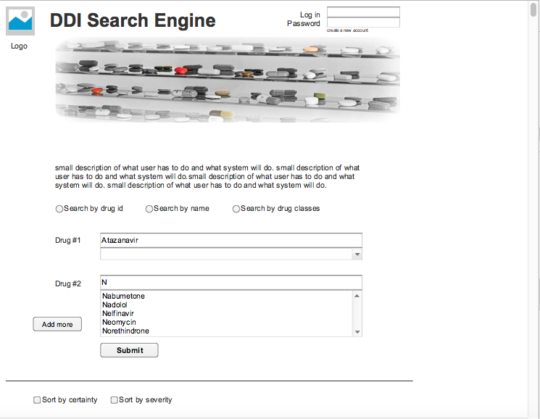

Slide 9
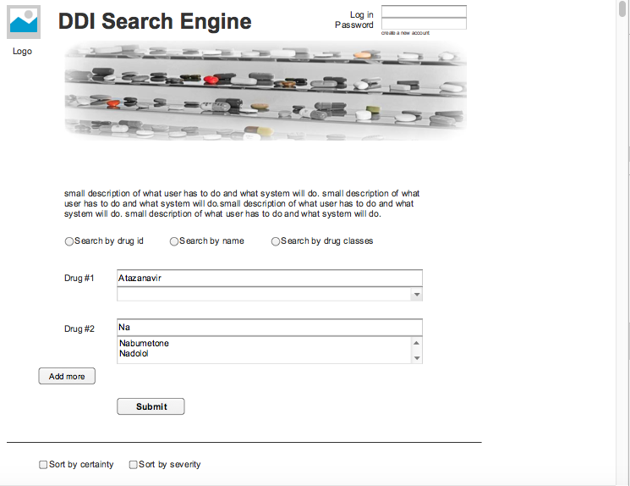

Slide 10



Slide 11


Slide 12


Slide 13


Slide 14
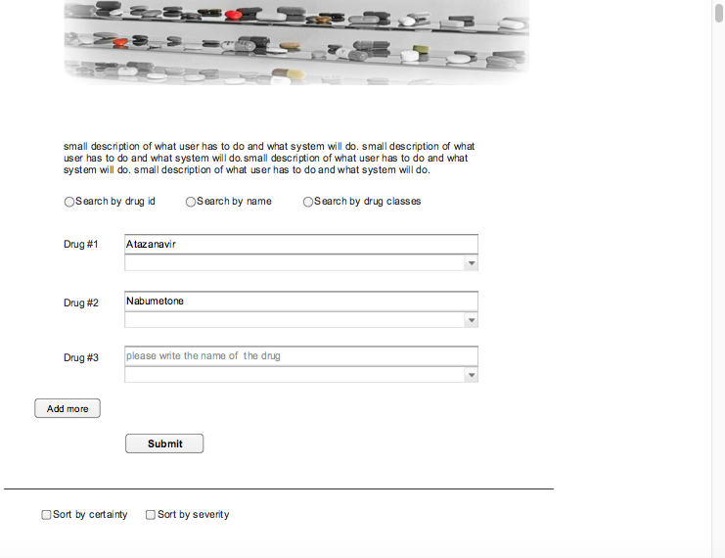

Slide 15
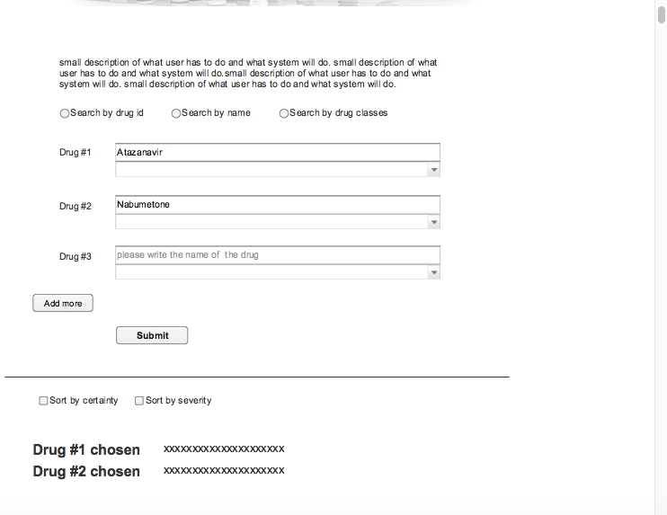

Slide 16
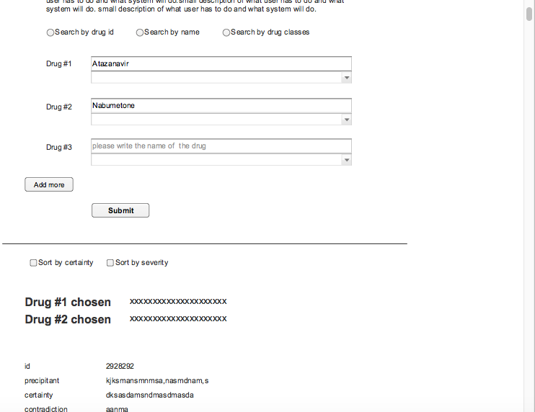

Slide 17
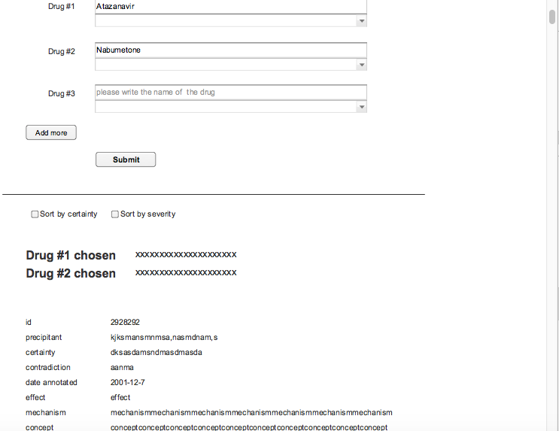
☑

Slide 18
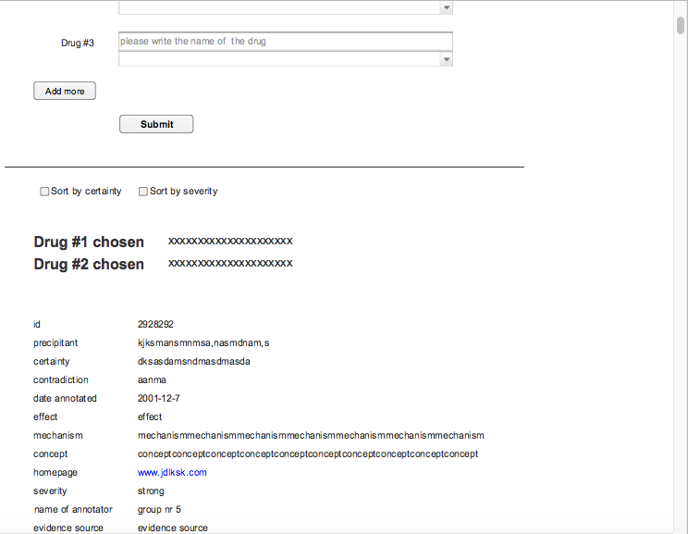
☑

Slide 19
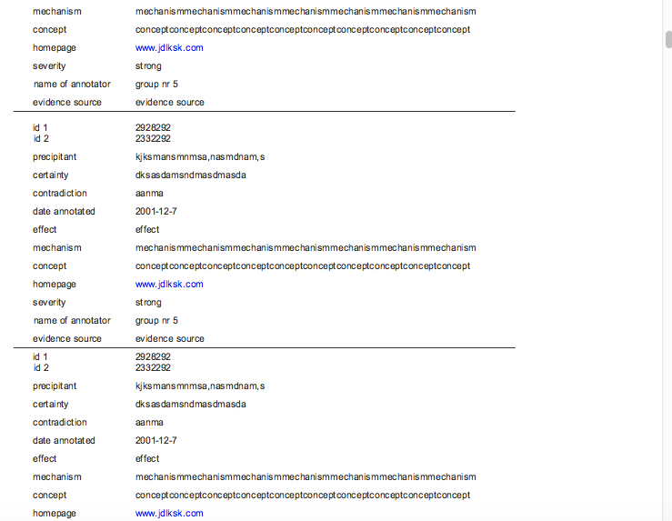

Slide 20
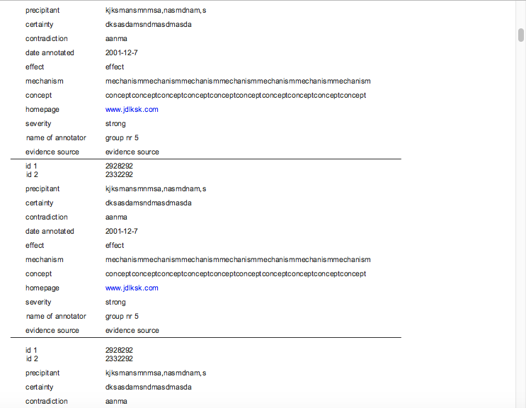

Slide 21
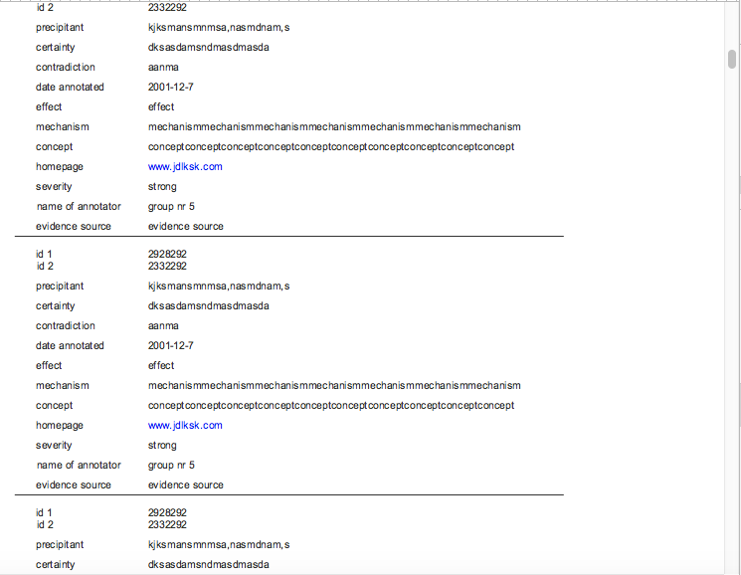

Slide 22
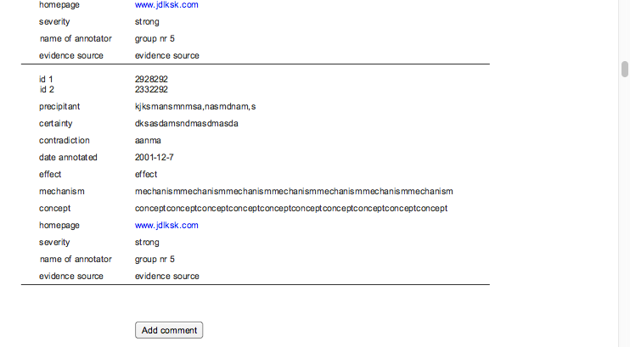

Slide 23
Our Comments:
* Login and Commenting will be include in the next design document
After ‘submit’ in order selected system will display each column (.csv) header name and the value it contains for the row. System will display it 6 times so from each source.
* For drug tree selection we would need a drawing from you as we don’t know the class and subclass node locations in tree.

